Slide 1
Year 8 Options Information Evening
6th February 2024

Slide 2
“‘The glory of God is each person fully alive”

Slide 3
Context & Vision…
The curriculum at St Paul’s encourages excellence and achievement by all pupils through the breadth of opportunity available, the quality of teaching and learning in the classroom and the motivation that comes from good relationships between staff and pupils.
.”

Slide 4
We truly value a broad and balanced curriculum which enables pupils to:
benefit from a holistic approach to education which values a broad and balanced curriculum from Year 7 to Year 11 which enables children to develop their personal gifts and talents, their spiritual, social, moral emotional understanding of the world.
strive to fulfil their potential ‘doing the best that is possible’
enables all children to achieve academic excellence
provides a rich and diverse range of experiences both inside and outside the classroom which values experiences such as Duke of Edinburgh, World Challenge and formal work experience
follow a PSHCE programme which equips children with knowledge of the world required to be a successful citizen
enables pupils to have a full understanding of British values which are promoted throughout all we do.

Slide 5
The Key Principles
Students in Year 8 will study a broad and balanced curriculum and will mostly begin their full GCSE courses in Year 10
Most students in Year 8 will eventually study 10 GCSEs
Students will continue to study BOTH History and Geography until the end of Year 9; enabling a broader and more in-depth understanding of humanities
Most students will continue to study a Modern Foreign Language until the end of Year 11
Students in Year 8 will be given the opportunity to choose one subject they wish to take through to GCSE in Year 11
Students will also be given the opportunity to choose an Expressive Art of their choice to continue to study until the end of Year 9
Students will still continue to study a technology subject through to the end of Year 11.

Slide 6
This year the biggest choice students have to make is their preferred Options Choice
Students will choose from one from the following:
Separate Sciences
Computer Science
Business Studies
Sociology
Art
Drama
Music
PE

Slide 7
When the subjects are chosen they will begin preparation for the examination specification giving them a real insight and preparation for their other examination subjects which they will embark upon in Key Stage Four
After this evening information gathering exercise, all will be invited to have a one-to-one meeting with a member of our Leadership team.
This is an opportunity for students to discuss their wider interests with us and share their future aspirations as well as ensuring they are making the best decisions to enable future success. Details of how to book these appointments are in the information packs you have been given.

Slide 8
Separate Science
Following a separate science route is
championed by the STEM (science, technology, engineering, mathematics) industries and the government as a whole.
Science can explain the mechanics and reasons behind the daily functioning of complex systems, from the human
body to electric cars, the
solar system to life under the sea.
Employers from ALL fields are crying out for skills that are explicitly developed as part of the Separate Science course: research methods, data processing, analysis, problem-solving, critical thinking and evaluation, these are particularly applicable if you are thinking of careers in law, finance, architecture, IT and many more
Notes:
Speech bubbles are quotes from our current Y11s about why people should choose sociology
Extra info: Reasons to study Sociology:
Better understanding of humankind – greater understanding of the complex nature of humans and the society we live in.
Broad skillset – the development of critical thinking supports your ability to make rational and carefully considered decisions in the interest of fairness. Develops empathy, communication and leadership skills
Helps us to understand and cope with the changes that occur in society – understand why changes happen and gives you the skills to cope with the changes that happen

Slide 9
Computer Science
We are living in the middle of a revolution powered by computers. It is very difficult to imagine a world without: social networking, transportation systems, medical systems, commerce/business, entertainment or scientific research.
We will study programming and computational thinking to help develop problem solving skills, resilience and perseverance and the application of basic mathematics.
At the end of Year 11 you will be assessed by two examinations.
Please contact Mr Abdulmajeed if you have any questions.

Slide 10
Business Studies
Business is hugely relevant to ‘real life’ – we are all customers and we will all work in a business organisation during our lifetime.
We study the nature of business activity, influences on business, finance, marketing and human resources, and how these help with the decisions firms make and, ultimately, business success.
At the end of Year 11 you will be assessed by two examinations.
Please contact Mr Tedds if you have any questions.

Slide 11
Sociology
The content is enjoyable and incredibly relevant to modern society, and it gives us a better understanding of the social world
If you're interested in exploring human behaviour and making a difference in society, then Sociology is a fantastic choice
GCSE Sociology helps students to gain knowledge and understanding of key social structures, processes and issues through the study of families, education, crime and deviance and social stratification
At the end of Year 11, you will be assessed by two examinations
If you have any questions, please contact Miss White
Sociology teaches students the ins and outs of society in ways they may have previously not noticed and inspires a desire to understand others and their reasons for thinking/doing things
Notes:
Speech bubbles are quotes from our current Y11s about why people should choose sociology
Extra info: Reasons to study Sociology:
Better understanding of humankind – greater understanding of the complex nature of humans and the society we live in.
Broad skillset – the development of critical thinking supports your ability to make rational and carefully considered decisions in the interest of fairness. Develops empathy, communication and leadership skills
Helps us to understand and cope with the changes that occur in society – understand why changes happen and gives you the skills to cope with the changes that happen

Slide 12
Art
GCSE Art will develop your skills in written communication, creativity, collaboration, personal organisation, historical/ contemporary knowledge and skills.
60% coursework and 40% exam (all project based assessments)
Art can lead to jobs in one of the fastest growing industries such as architecture, games design, photography, illustration, museums and so much... more...
Our year 13 student Daisy talks about Art in her own words. She had to make a choice when she was in year 8 too and she explains why she thinks it was right for her.
Please contact Mrs Reeve if you have any further questions- ines.reeve@st-pauls.org.uk

Slide 13
Drama
Pick Drama if you:
•Want to increase your confidence in presenting in front of others
•Have an interest in theatre, acting and stagecraft
•Want a career that relies heavily on teamwork, selling, analytical thinking and creativity
•Like to learn in a practical, hands-on way
•Want to go to the theatre!
•Want to develop your cross-curricular understanding, particularly with English
•Want to explore theatrical elements such as lighting, costume, set design and sound
The Drama course:
Component 1: Devising – a devised performance supported by a portfolio of written work 40%
Component 2: Performance from a text – a visiting examiner marks you performing 2 extracts from a play text 20%
Component 3: Theatre Makers in Practice – a written exam where you are given an extract from An Inspector Calls to be questioned on and questions on a production you have seen 40%
If you have any further questions about Drama, then speak to Miss O'Sullivan or Mrs Dalkin

Slide 14
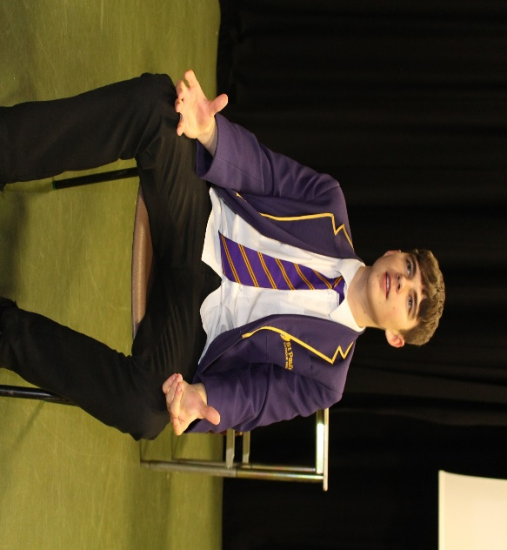
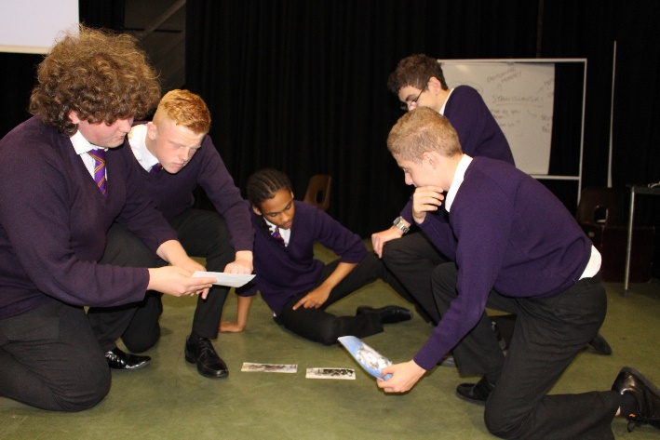
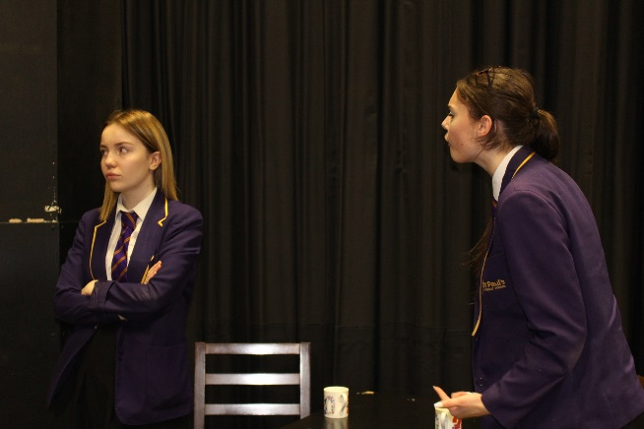
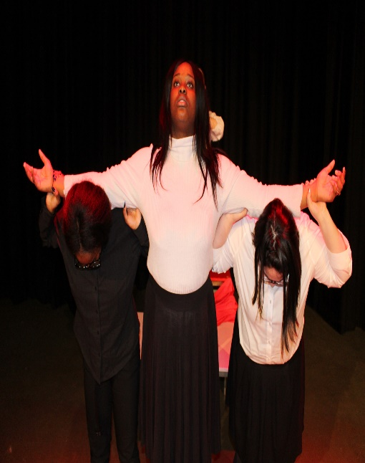
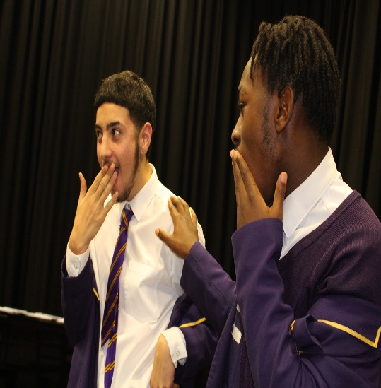
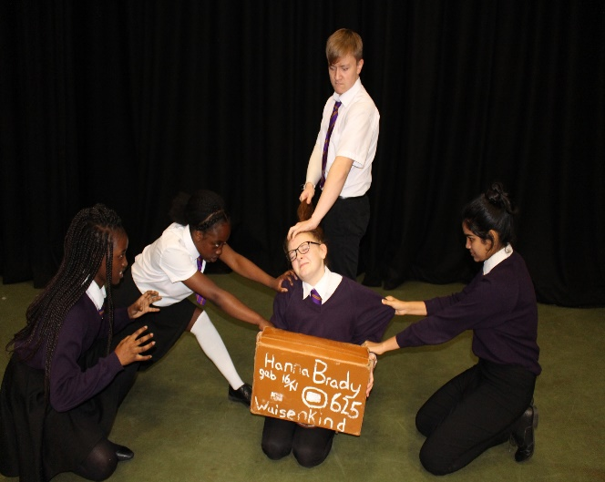
Drama Lesson Photos

Slide 15
PE
If this is you, then you might want to consider selecting PE;
•Play at least one sport outside of school or for the school team.
•Have an interest in training, diet and preparation for sport.
•Intrigued about how the body works within a sporting context.
•Able to sustain a good level of physical fitness.
•Is reflective and can identify strengths and areas to improve in their own and others performances.
•Can apply knowledge to a wide variety of sporting examples.
If you are interested in the following, then PE might be the option for you.
•Understanding how our bodies work during exercise and how to progress towards a goal.
•Learning a range of practical skills and tactics which can be transferred within a number of sports.
•The opportunity to perform competitively against others.
•Enjoy working within a team to achieve an outcome.
If you have any further questions about PE, then please contact Mr Coates

Slide 16
MUSIC
“Without music, life would be a mistake” – Friedrich Nietzsche
Music can help you focus, cheer you up as well as develop your confidence!
Music has been proven to help improve our memory and helps you relax.
It can also lead to lots of careers such as:
Performing
Songwriting
Composing
Live music entertainment
Music education / teaching
Music production
Artist management
marketing and PR
music journalism
Sound engineer
Graphic designer
Broadcaster / DJ

Slide 17
YOUR NEXT STEPS…..
Visit the subject stalls
Gather your information
Think about your preferences, strengths & what you enjoy
Appointments with members of the Leadership and Year 8 Pastoral team will begin after February half term
The School Cloud booking system will be open as of tomorrow for you to make your appointments.

